Slide 1


Centre for Digital Public Infrastructure
IDs - functional & foundational
DPI Building Block in Focus

Slide 2

Thailand
In under two years, ThaiID reduced the share of population uninsured by healthcare from 29% to under 5%
Launched in 2019, used to guarantee subsidized health care to all citizens
Source: Wilson et al, 2021
Notes:
Ia juga memastikan bahawa individu secara automatik dipindahkan dari satu bahagian senarai insurans ke bahagian lain apabila perubahan dalam status kerja mereka mengubah cara mereka dilindungi.

Slide 3
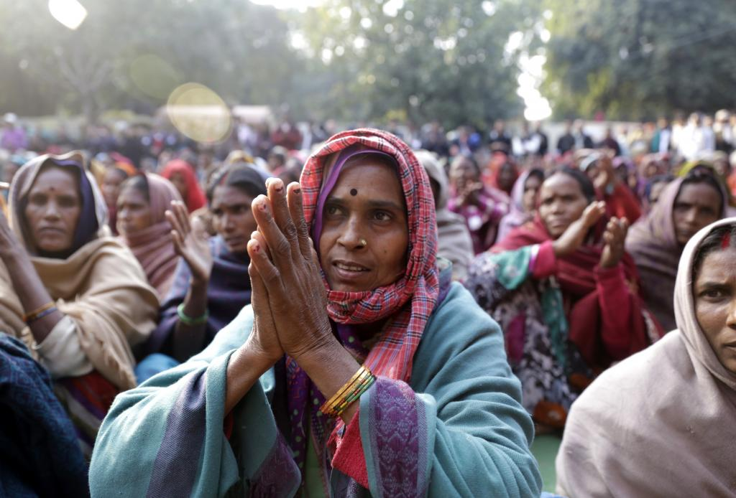


As of 2008, India was one of the world’s
most unbanked
Less than 20% banking penetration

Slide 4
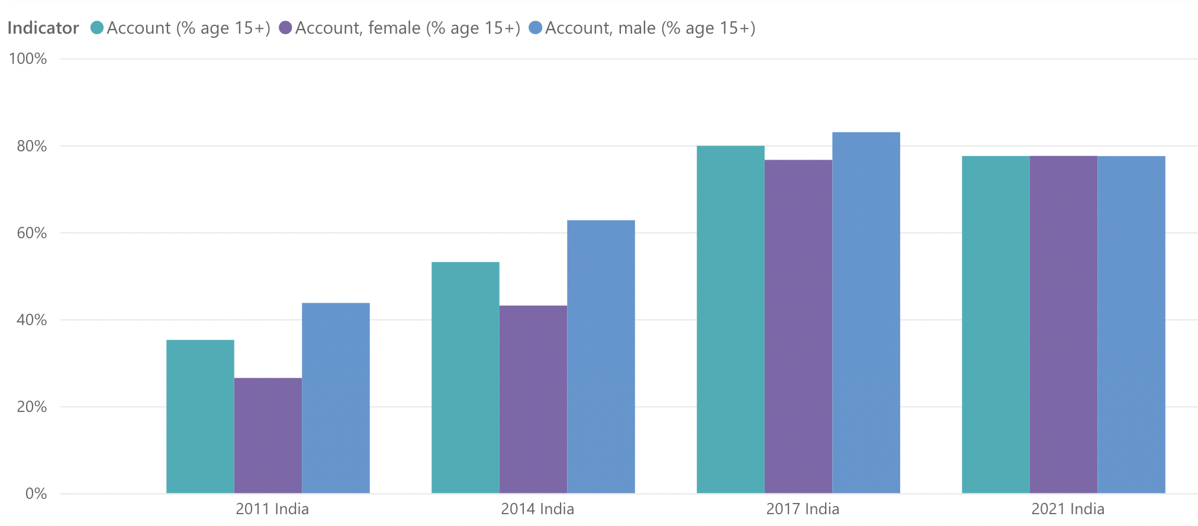


In 9 years, India’s banking penetration shot up from
<35% to ~80% using a digital ID, closing the gender gap!
80%
83%
78%
78%
78%
77%
63%
53%
44%
43%
35%
27%
Sources: World Bank Findex Data 2011-2021: https://www.worldbank.org/en/publication/globalfindex/Data
Notes:
462 juta akaun telah dibuka, BIS menganggarkan ini akan mengambil masa 50 tahun.
56 peratus daripadanya adalah milik wanita, dan 67 peratus daripadanya berada di kawasan luar bandar dan separuh bandar.
Ia adalah 47 tahun dan 9 tahun untuk menjadi tepat.
Ia kurang daripada 10% pada tahun 2008, 80% pada tahun 2017

Slide 5

Countries do not need to create brand new ID systems
Can build on many existing ID systems…
Existing ID
database
Auth/eKYC
modules
…By adding
auth & eKYC!

Slide 6

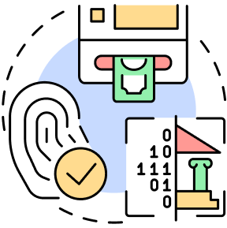

Capabilities of a Digital ID
Authentication:
Returns Y/N to the question “Are you who you claim to be?”
eKYC:
Authentication + Profile Information Sharing
Avoids recollecting data across services

Slide 7


The only way to keep an ID system accurate is ensure that it’s used regularly!
ID auth & eKYC increases
Usage of ID system for services
Driving increased coverage
and ensuring that data is kept up-to-date

Slide 8






India’s Digital ID Infrastructure
For Private & Public innovation
860 M
ID linked bank accounts
90%+
Mobile density
470 Mn opened in 8 yrs!
102 Bn
ID AUTHENTICATIONS
16 Bn
e-KYC TRANSACTIONS
AADHAAR
Unique digital identity
1+ Bn auths / month
Random 12 digit number
Only 4 mandatory data fields
+ biometrics
1.38 Billion
Unique ID Numbers Issued
Source: https://uidai.gov.in/
‹#›
Content of this deck is licensed under CC BY-SA 4.0
‹#›

